Slide 1
Introduction and Overview

Slide 2
Introduction
Goals of Machine Learning
Classification
Intro to Neural Nets
Intro to Rules
Notes:
This section will cover the goals of the course, machine learning via classification, the basics of neural nets and an outline of expert systems. Together with the section that follows it, it will enable you to select the area of your term project.
We will be returning to expert systems, and especially neural nets in detail when we have completed this overview.

Slide 3
Learning Objectives for This Class
Define course goals
Distinguish between techniques
  classification
  neural nets
  expert systems
Begin comparisons
Notes:
By covering the basics of various techniques, we will compare how they can be applied.

Slide 4
Reasons for Emergence of ML
Prevalence of data
Competition
Notes:
There has been R&D in machine learning (ML) since at least since the 80’s--notably, the First Machine Learning Workshop was held in 1980 at Carnegie-Mellon University.
I believe that the field has taken off over in the 201X’s due to:
The merging of neural nets into AI and
The prevalence of a huge amount of online data
ML has shown itself to be eminently practical, and competition among the world’s leading corporations is accelerating its development.

Slide 5
ML Methods: A Characterization
Input
Model
Output
Notes:
Since the course deals with several kinds of ML approaches, we need a way to compare them. We’ll do this by discussing the kind of inputs each one accepts (e.g., vectors), the kind of outputs, and the nature of its model. A model is the way that the approach views the problem.

Slide 6
Introduction
Goals
Intro to Classification
Intro to Neural Nets
Intro to Expert Systems
Notes:
Given a set of data, we will discuss in this section how machine learning (ML) methods can be used to separate it into groups, each with commonality. We will describe support vector machines (SVM’s) as a way to do this.

Slide 7
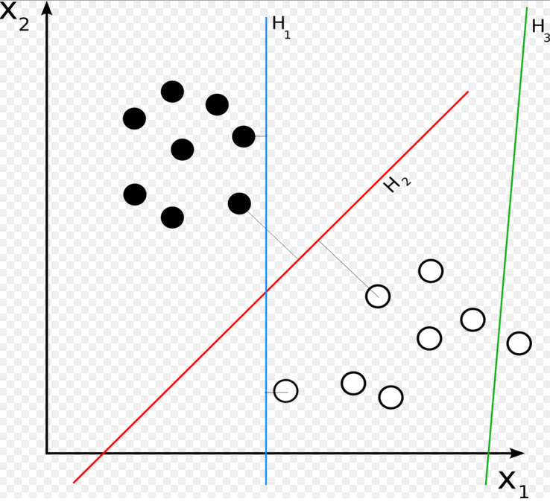
Linear Partition
http://en.wikipedia.org/wiki/Linear_classifier#mediaviewer/File:Svm_separating_hyperplanes.png
Notes:
A common ML problem is to learn a classification of data into one of two sets in such a way that new data can be allocated to one of the sets. This is learned from existing labeled data. In other words, the each existing data point is already classified into one of the two sets. In the figure, consisting of dots, they are labeled white or black. The problem is to learn from this how to classify future data.
More generally, we might decide in advance that we want separation into a number of sets other than two. In fact, the decision as to how many sets are appropriate is itself a problem.
In this example, each data point consists of two numbers (or fields). (The 2 fields and 2 sets is just coincidence—these are independent numbers.) If we are lucky, a straight line can be drawn that separates one set of (labeled) data points from the other, and this line can be used for classification. There may be many such possible lines. To more fully exploit the given information, however, we would select the straight line with equal minimum distances to the closest black and white data points, as shown by line H₂ in the figure. This attempts to equalize the weight of the data because the potentially most ambiguous area between the two groups is evenly split.

Slide 8
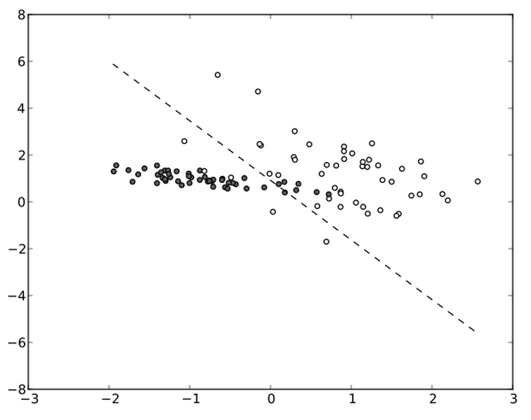
Support Vector Machines
2 dimensions
http://en.wikipedia.org/wiki/Support_vector_machine#mediaviewer/File:Linear-svm-scatterplot.svg
Notes:
More realistically, data tends to be mixed, with no demarcating straight line, as in the figure. In that case, various techniques can be used to devise a straight line whose classification properties are optimized in some sense. There is typically no perfect line because the data is rearely “perfect.” We must decide what to optimize for. A reasonable criterion is the sum of the distances of the points to the line where data points on the wrong side are counted negative.
Making decisions like this is a form of heuristics, where the human makes choices that appear to be sound. These are then tested. This empiricism is a theme in ML: the need to experiment and test.

Slide 9
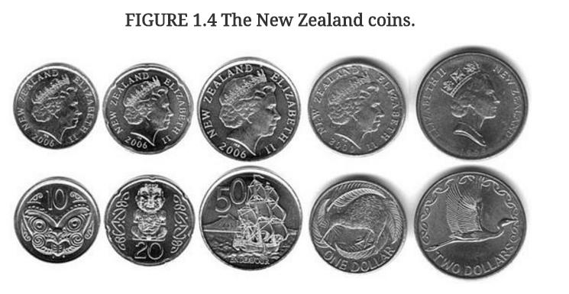
Nonlinear Classification Learning 1
Marsland
Notes:
In his textbook, Marsland uses this example of a system that distinguishes among three kinds of coins as shown. In other words, after the system learns from data labeled with one of the three types, it should be able to recognize a coin. This is just an example: the classification technique under discussion here is not necessarily the best one for this application.
The differences here with the previous example are:
There are 3 rather than 2 sets (or “types”) and
There are probably more than two dimensions (or axes in the figure) that describe each datum. One axis would probably be coin size (absolute size is ideal, otherwise size relative to the average in the sample might need to be used). Another might be color (e.g., degree of bronze vs. silver), another “bird-like” perhaps.

Slide 10
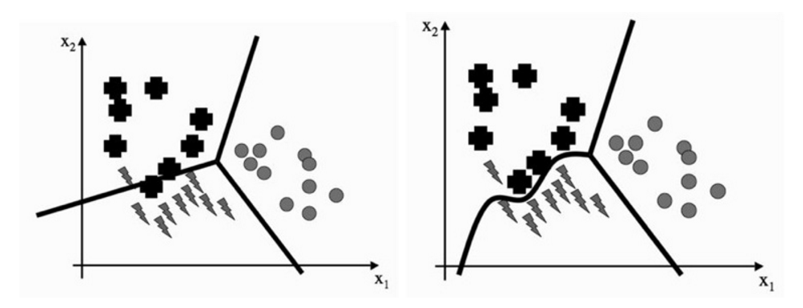
Nonlinear Classification Learning 2
Marsland
Notes:
We have discussed straight-line SVM classifiers (in general dimensions, referred to as hyperplanes). This is computationally convenient—and probably relatively fast—but usually not as effective as curved lines. The difference is shown in the figure. Computing with straight lines (or hyperplanes in general) is relatively straightforward. The use of curved surfaces can be complex. Where feasible, we try to use hyperplanes.

Slide 11
Introduction
Goals
Intro to Classification
Intro to Neural Nets
Intro to Expert Systems
Notes:
This section introduces a major kind of machine learning: neural nets. We will later spend more time with this ML technology than any other, and discuss TensorFlow, an implementation language for them.

Slide 12
Neural Nets: What?
A problem-solving technique that simulates neurons and their interaction.
Notes:
Neural nets are based on aspects of the brain. A Neural net consists of neurons—cells that take input from and provide output to other neurons. Importantly, a single neuron does not seem to encode knowledge as we understand it. Knowledge is encoded by the set of connections between neurons.

Slide 13
Application Examples of Neural Nets
Checking loan applications (Chase)
  input: past application / success pairs
  result: net usable for new applications
Recognizing handwriting (Apple)
  Input: sample pairs of script / print
Credit card fraud detection
Predicting investments (Nikko; Fidelity)
Real estate appraisal
Predicting hospital stays ...
Notes:
The idea of simulating interconnected neurons has led to many applications, some of which are listed here. The rate and scale of applications has become immense—too long to list, really.

Slide 14
Neural Nets: Example Applications ctd.
To recognize anomalous bit patterns on a communication line.
To recognize handwriting.
Learns to discriminate sounds
Diagnostics
  Medicine
  Autos
  Plant repair
  ….
Notes:
Image recognition is also a major application of neural nets.

Slide 15
Examples of Neural Nets
System that learns to discriminate sounds
Diagnostics
  Medicine
  Autos
  Plant repair
  ….

Slide 16
Neural Nets: More Examples
Signal recognizer
  voice recognition
Scene recognizer
Stock picker

Slide 17
Neural Nets : Use when ...
Input
Model
Output
No model or expertise is known
Input/(output) examples are known
Input and output can be encoded as vectors
Notes:
We typically use neural nets when we don’t have a model of how a process actually works. But we must have a set of actual input/outputs. These are mostly from the real world. The input and output of a neural net must each be a vector—an array of numbers.

Slide 18
Neural Nets: Input
Input
Model
Output
Vector of real numbers
  (or convert to this form)
Notes:
It is actually possible to represent input as an array of numbers, in many cases.

Slide 19
Neural Nets: Output
Input
Model
Output
Vector of real values
giving answers
consistent with performance on examples
Notes:
Once the architecture of a neural net has been decided (i.e., the interconnection pattern and the nature of each neuron’s data processing), it is fed a set of input/output pairs. These form the training set. When successfully trained, the net gives the respective output for each input to within a tolerable error. It is then ready to be tested and used on any input.

Slide 20
Neural Nets : Model
Set up processing elements (“neurons” or “nodes”) that behave like human brain neurons, with connections. Adapt the weighting on the connections to adapt the neural net to the problem.
Notes:
In many ways (even though they are modeled on brains), neural nets are “dumb.” Once we set one up, it learns from input/output data by making many numerical adjustments. We don’t model how neural nets actually work beyond that: we often can’t form much of a vision about why exactly they end up the way they do. Sometimes we get an idea of this, however.
An important skill is in how we architect (“wire” so to speak) each neural net application in the first place, i.e., prior to training it. This will be explored later in the course when we focus on neural nets.

Slide 21
Modelling Neuronal I/O
* Output =
f (wo + w’o’)
*
*
*
Process
Transfer function
input wo+w’o’
weight w
weight w’
Notes:
In software, we model each connection with a number (the weight) that reflects its relative strength.
Each neuron in a neural net takes as input the sum of a output of other neurons, weighted by the connection strength. It then applies a function (a transfer function) to this quantity. The output of this function becomes an input to other neurons (after weighting), or else it is the output to the whole neural net.

Slide 22
Modelling Neuronal I/O
Process
Process
Process
*
*
*
Process
Neuron simulation
input wo+w’o’
weight w
weight w’
output o
output o’
Process
Process
Notes:
This figure shows how a (simulated) neuron interacts with other neurons.
As with (what we know about) biological neural networks, learning consists mainly of modifying weights.

Slide 23
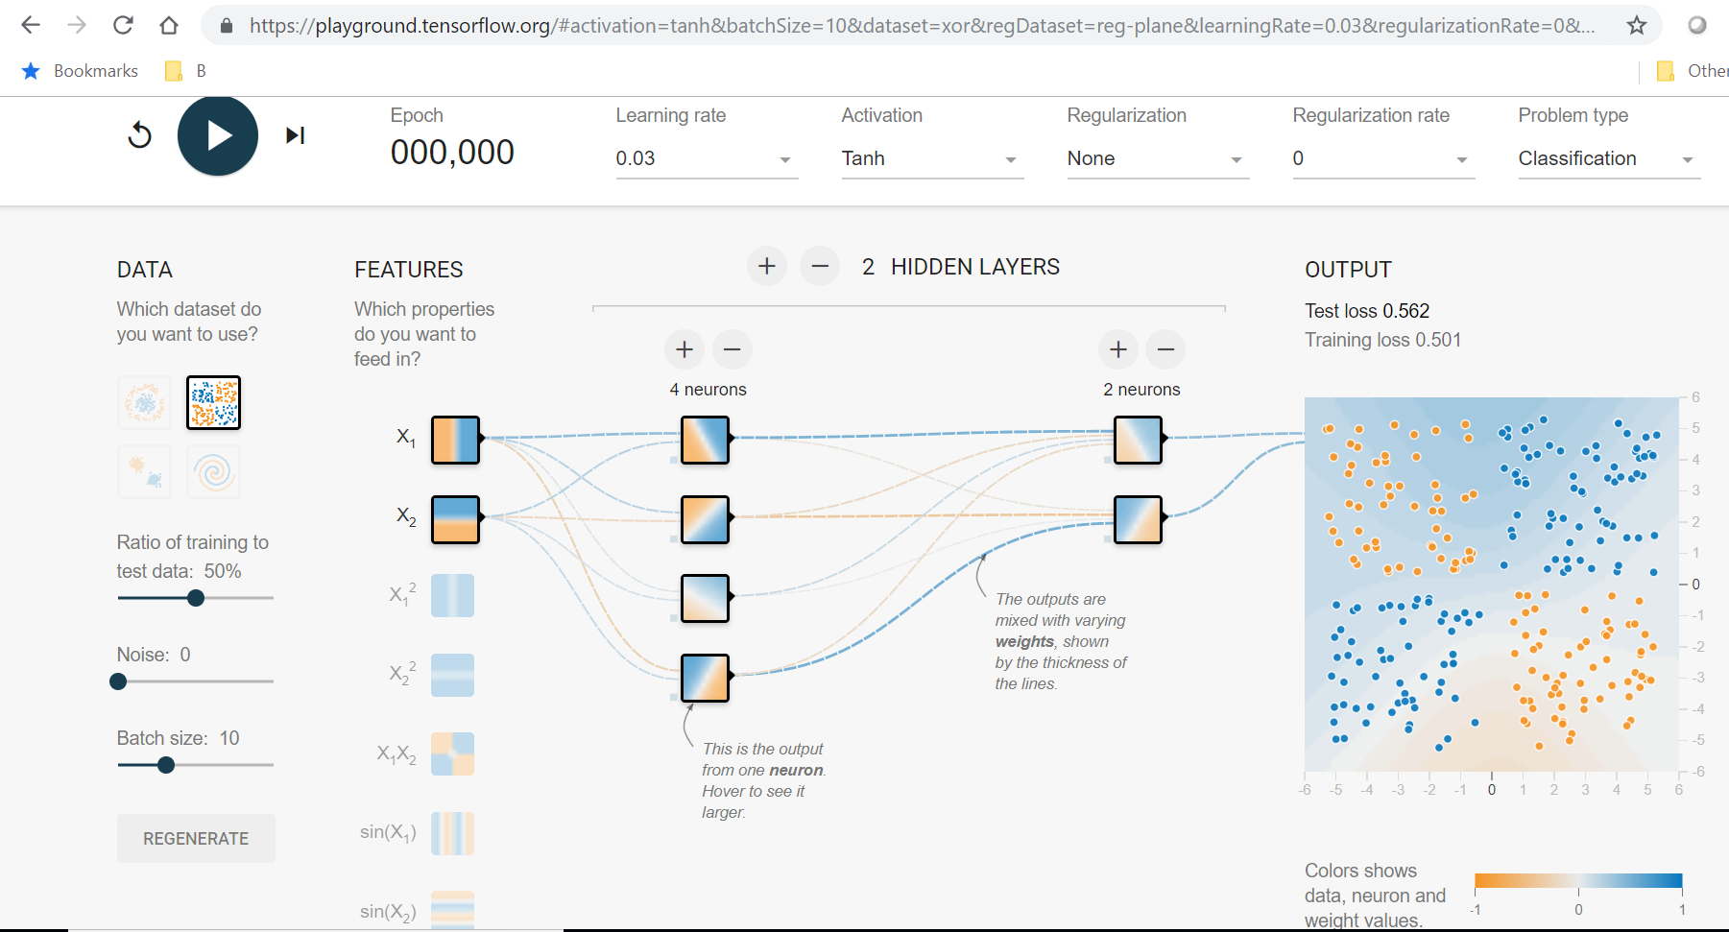
TensorFlow Playground Demo
http://playground.tensorflow.org/#activation=tanh&batchSize=10&dataset=circle&regDataset=reg-plane&learningRate=0.03&regularizationRate=0&noise=0&networkShape=4,2&seed=0.49760&showTestData=false&discretize=false&percTrainData=50&x=true&y=true&xTimesY=false&xSquared=false&ySquared=false&cosX=false&sinX=false&cosY=false&sinY=false&collectStats=false&problem=classification&initZero=false&hideText=false

Slide 24
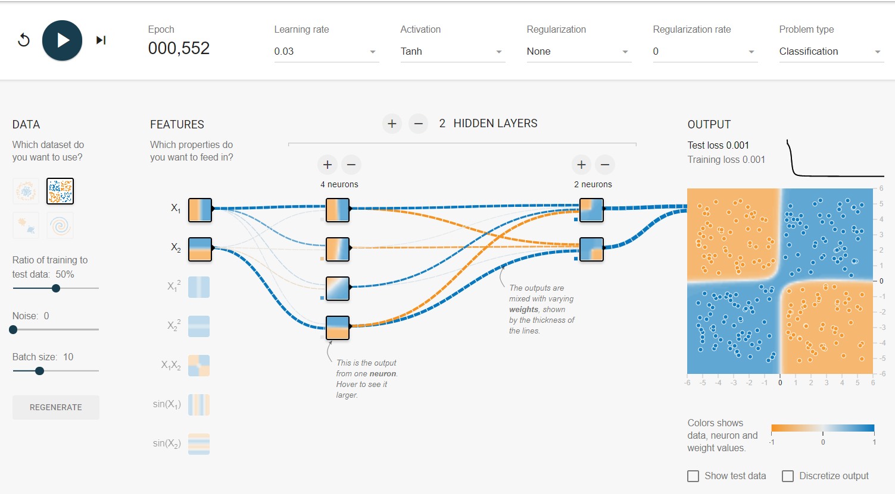
After Training

Slide 25
Deep Learning
Neural net architecture
Organized in layers
Each of higher order
  Example: text summary
  Sentence syntax
  Sentence sense
  Story sense
Notes:
A major reason that neural nets have been so successful in the second decade of the 21st century is deep learning. This is characterized by multiple layers of neurons and massive amounts of training data. These were tried for many years without much success; however, persistence, various new techniques, the availability of massive data sets, and increased computation power, which we will describe later in the course (in the neural net modules), made success possible.

Slide 26
Neural Nets: Characteristics
Must have data (-)
Must represent all I/O numerically (-)
Cannot explain itself understandably(-)
No model needed (+)
Potentially very fast(+)
Many possible configurations (+)
Notes:
The figure sums up the pro’s and con’s of neural nets.

Slide 27
Neural Nets: Characteristics
Takes long time to train (-)
Fast execution (+)
Hard to verify (-)
Cannot explain itself well (-)
Many competing NN methods
Notes:
Continuing with pro’s and con’s: most neural nets are slow to train, fast to execute, and virtually unable to explain how they reach their conclusions. A vast amount of research is underway to mitigate the negatives, so this situation changes over tims.

Slide 28
Introduction
Goals
Intro to Classification
Intro to Neural Nets
Intro to Expert Systems
Notes:
The final topic for this part is expert systems. Recall that neural nets, once configured, learn everything. In particular, they being knowing absolutely nothing about the problem. For example, if the input/output data is “symptoms/bad parts” for a car, the system starts knowing nothing about cars—not even if the battery has no power the can will not start.

Slide 29

Classical Expert Systems: What?
A problem-solving technique that encodes human expertise.
Machine Learning: learn rules from data.
Notes:
When we use the term “machine learning,” we are referring to machines (i.e., software) learning knowledge of some kind.
If we already know something about solving a problem, why not exploit that knowledge? This is the basis for expert systems: they are specifically designed to utilize knowledge about solving problems. Traditionally, expert systems work on an encoding of human knowledge. This has been broadened by some to include other sources of knowledge, and it relates to machine learning because in many cases, we can think of machine learning as achieving understanding that can be compared with human knowledge.

Slide 30
Expert Systems: Use when ...
Input
Model
Output
Model = knowledge in person’s mind
  or people’s minds
  or derived from data
There is no other convenient model
  e.g. mathematical, physical
Notes:
Expert systems, in contrast with neural nets, do have models. But the model is essentially psychological in the sense that it resides in a human mind (or minds).

Slide 31
Examples of Expert Systems
Legal advisor
  (e.g., The Economist 3/12/05 p34)
Medical Advice
Diagnostics
  Medicine
  Autos
  Plant repair
  ….
Notes:
Expert systems are often good at diagnostics. They are less often associated with synthesis—the creation of entities. Actually, few of the machine learning techniques covered in this course are good at learning to make things (neural nets are in that category). The exception is genetic algorithms, which we will cover in the next section.

Slide 32
Expert System: Example
To analyze user’s physical fitness, and provide techniques and strategies for desired fitness.

Slide 33
Expert Systems: Input
Input
Model
Output
Characteristics of the problem instance
  sometimes exact
    e.g. 68 inches tall
  sometimes inexact
    e.g. feel great
Notes:
Expert systems accept input of all kinds. For example “patient is often fatigued.” Unlike neural nets, expert systems can accept symbolic (non-numerical) inputs like this. They can also accept numerical inputs, although those are often converted to non-numerical ones. For example, Johnny’s is 15 years old might be converted to “Johnny is a teenager.”

Slide 34
Expert Systems: Output
Input
Model
Output
Usually “good” solution
Seldom optimal
Inexact
  e.g. “your are suffering from depression”
  e.g. “exercise 3-4 times a week”
Notes:
The output to an expert system is usually symbolic. It is frequently inexact, such as in the examples shown.

Slide 35
Expert Systems: Model
Encode knowledge in a standard form, typically rules;
execute algorithms that reason among the rules to reach conclusions.
Notes:
Besides the knowledge about the problem—which forms the model, and which is typically expressed in terms of rules, expert systems are equipped with a means of reasoning. An example of rules are cats are nimble and animals named Felix are usually cats. A reasoning (or inference system) can take the input Alfred’s pet is named Felix and use the rules to infer Alfred’s pet is probably a cat.

Slide 36
Knowledge = Facts + Rules
Inference
Engine
Knowledge
base
facts
pure rules
Notes:
Expert systems consist of the knowledge base and the inference engine that reasons with it. The knowledge base is further subdivided into facts and rules. Alfred’s pet is named Felix in the previous example is a fact.

Slide 37
Rule Terminology
IF animal has stripes (fact)
AND
animal roams in large herds (fact)
THEN animal is zebra (fact)
OR
animal is okapi (fact)
Notes:
The knowledge in an expert system is usually expressed in terms of rules. Rules use facts, as in the figure.

Slide 38
Expert Systems: More Examples
Bacterial blood disease diagnosis
Tool selection for problem solving (!)
Credit card approval
Wizards
Notes:
Expert systems have been used, with varying degrees of success, on medical applications, credit approvals etc.

Slide 39
Expert Systems: Characteristics
Knowledge must be collected (-)
  arduous
  inexact
Tend to be slow (-)
Validity questionable (-)
Only alternative when source human (+)
Can explain itself understandably (+)
Represents domain experts well (+)
Hence ML
Notes:
Collecting knowledge and encoding it is time-consuming. Expert systems need to reason, which can be relatively slow. Sometimes their validity is questioned: for example, how many rules is enough? Too few?
On the other hand, it is relatively easy to have an expert system explain its conclusions by producing a trace of its reasoning. And, of course, when expertise is available, expert systems are ideal for capturing their specific knowledge.
These pro’s and con’s are almost the opposite of those for neural nets, as we shall see.

Slide 40
Summary
Try SVM classification for a simple approach
Neural Nets often work, given voluminous input/output data
Expert Systems apply explicit human knowledge
—if you have it, use it

